Slide 1
Thermal Mapping of Urban Heat Islands Using Satellite Imagery and Computer Vision
Presented By
Anita Baral
Noah Greenbaum
Prakriti Adhikari

Slide 2
Introduction
What are Urban Heat Islands (UHIs)?
Areas with significantly higher temperatures in urban settings compared to rural surroundings.
Reason Behind Urban Heat Islands (UHIs)?
Caused by heat-absorbing materials, decreased vegetation, and anthropogenic heat sources.

Slide 3
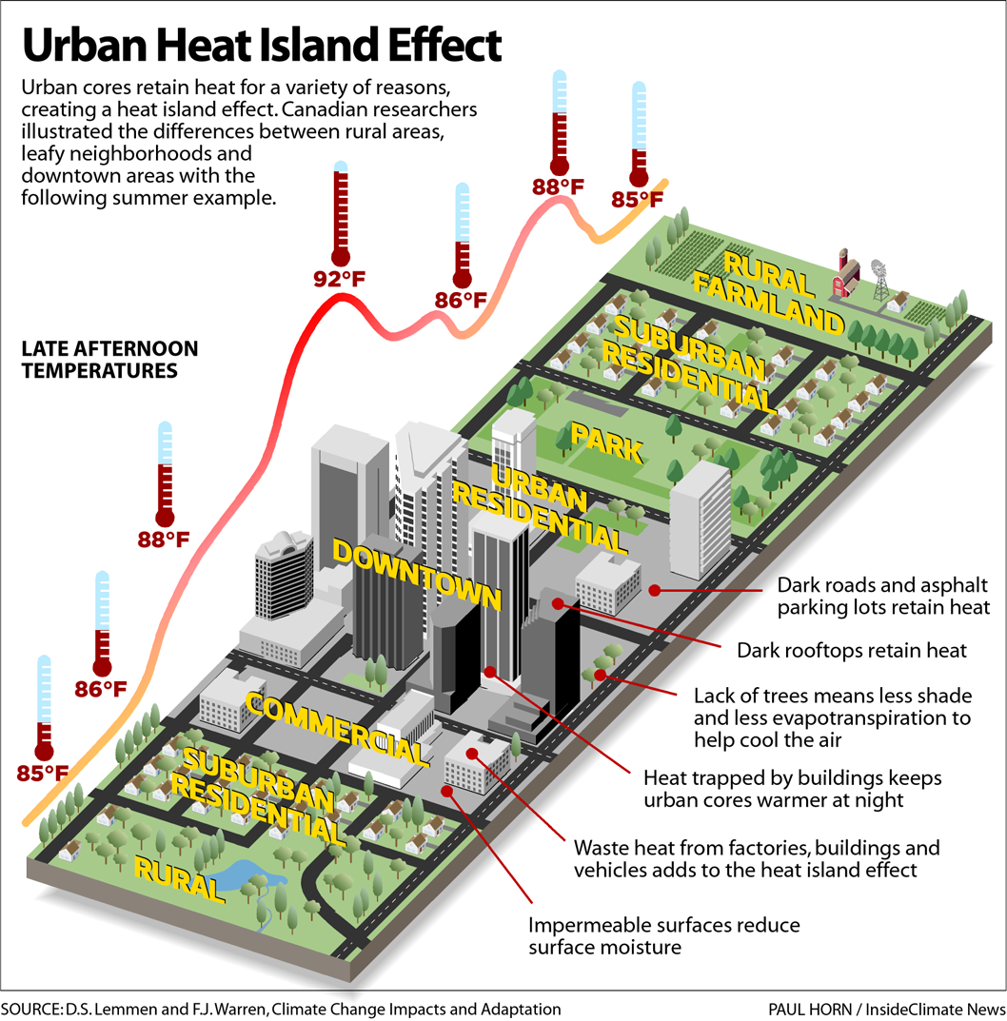

Slide 4
Background
Objectives
Map and analyze UHIs using Landsat 8/9 thermal imagery.
Overcome challenges such as spatial resolution and atmospheric distortions.
Provide data-driven insights for sustainable urban planning.
Impacts of Urban Heat Islands (UHIs)?
Increased energy consumption.
Public health risks.
Environmental degradation.

Slide 5
Methodology
Data Collection
Selected major cities of ohio like dayton, springfield, sydney, etc.
Used Band 10 (Thermal Infrared) from Landsat data to derive the Land Surface Temperature Map (LSTM).
Used Band 4 (Red) and Band 5 (Near Infrared) to derive the NDVI Map.
Utilized OSM to provide detailed maps of urban areas, including roads, buildings, and land-use zones.
Incorporated GeoJSON datasets to verify and overlay building data accurately on the OSM base map.

Slide 6
Data Preprocessing
Cloud Masking: Filtered out cloud-contaminated data by setting cloud percentage to 0-4% for clarity.
Handling Missing Data: Interpolation to fill gaps in NDVI and LST values.

Slide 7
NDVI and LST Calculations
NDVI: Identifies vegetation density (higher values = more vegetation) utilizing band 4 and band 5 data from landsat.
LST: Measures surface temperature to detect heat anomalies utilizing band 10 data
from landsat.

Slide 8
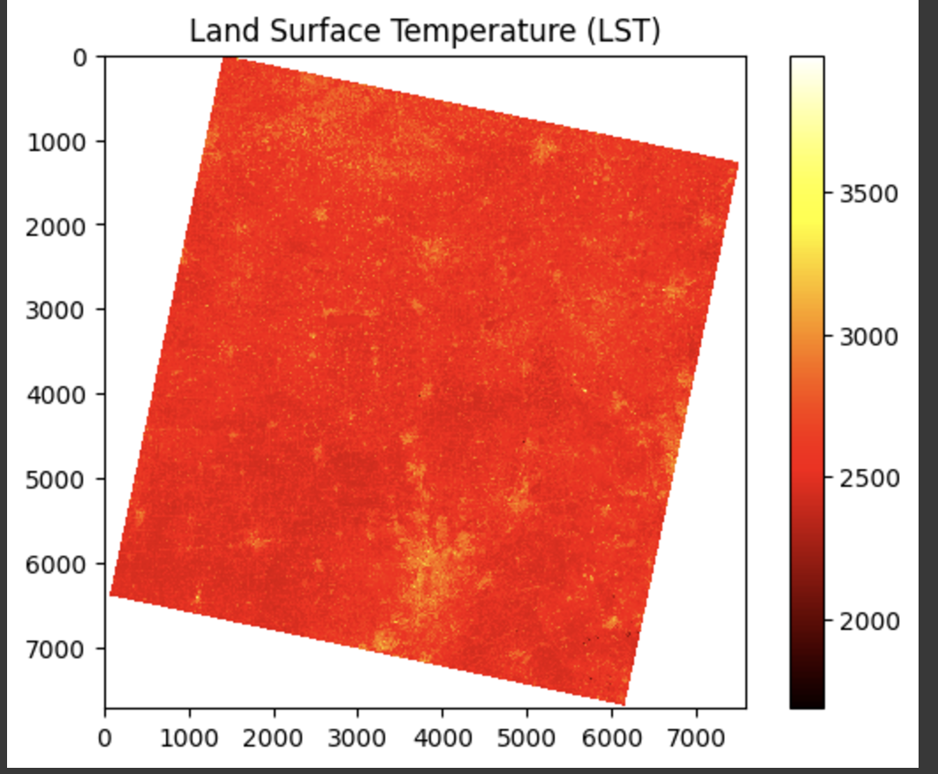
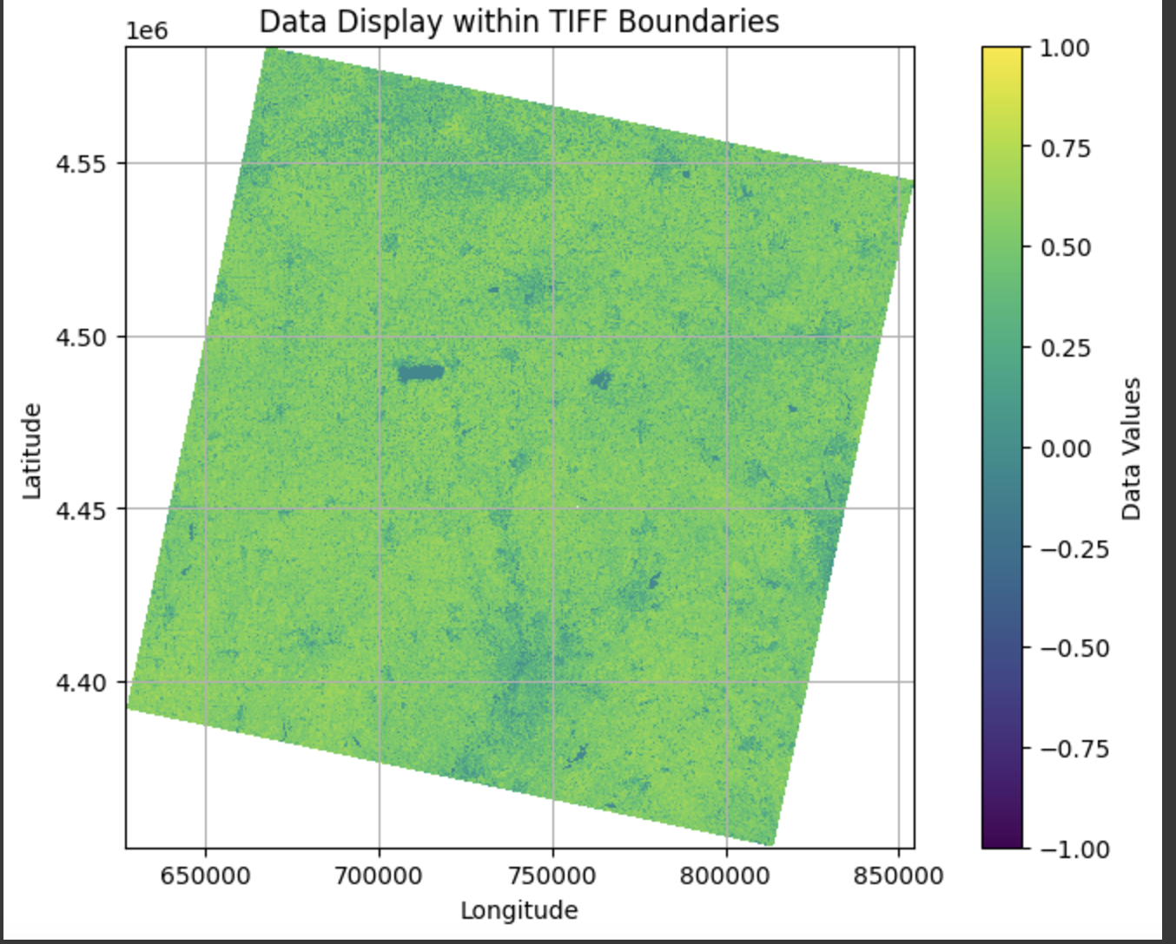

Slide 9
Heatmap Generation
We combined the NDVI and LSTM values to generate heatmaps.
Three methods were employed to generate the heatmaps and delineate UHI hotspots
Threshold method
K-means Clustering
Random Forest

Slide 10
Heatmap Overlay on OSM
The UHI effect map integrates NDVI and LST data to provide a comprehensive visualization of heat-affected zones.
The overlay of the heatmap on OpenStreetMap further validates the spatial alignment of UHI hotspots with urban structures. The results indicate that areas with dense building concentrations, such as commercial or residential zones, experience significantly higher UHI intensity, while vegetated areas demonstrate a notable cooling effect.

Slide 11
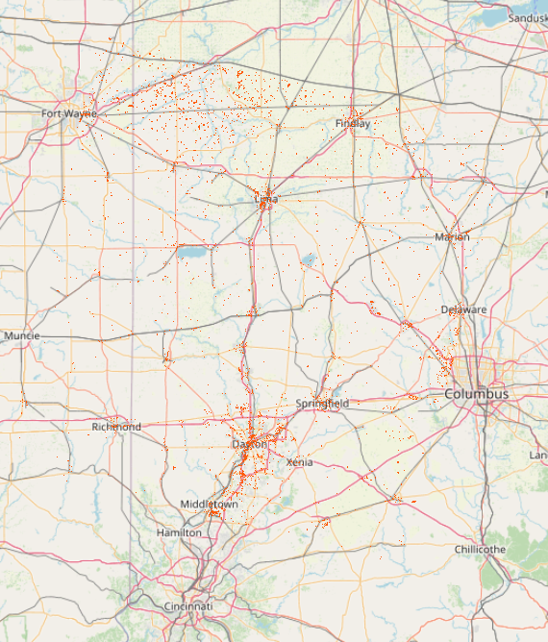
Heatmap Generation Methods
Threshold Method
By applying a predefined temperature threshold to the LSTM values, areas that exceed the threshold are classified as UHI hotspots.
Regions are classified as UHI hotspots where:
NDVI is less than 0.2 (indicating built-up areas with low vegetation).
LST exceeds the 90th percentile.

Slide 12
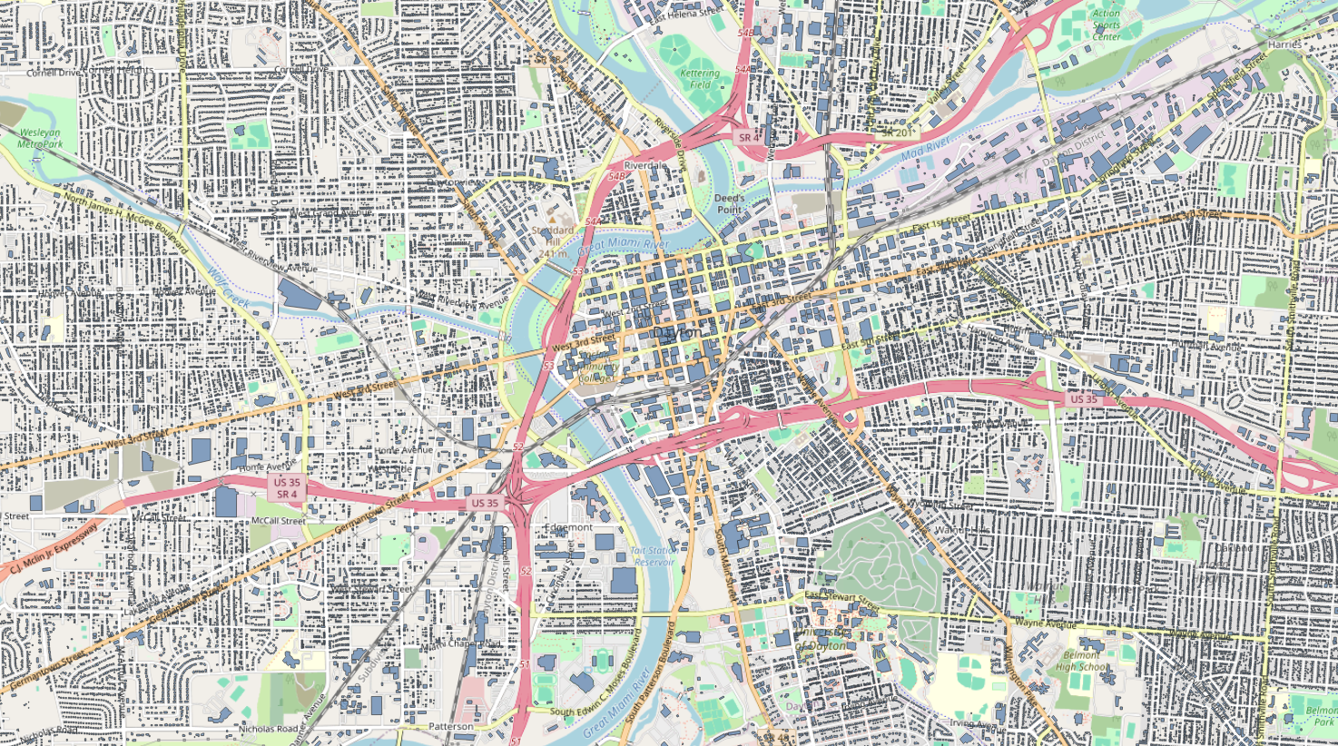
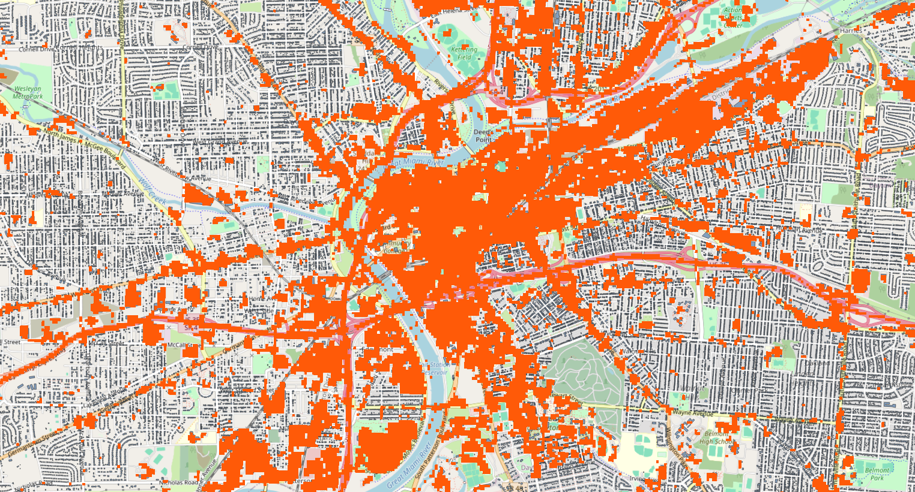
Overlay of Buildings and Urban Heat Island in Dayton (OSM)

Slide 13
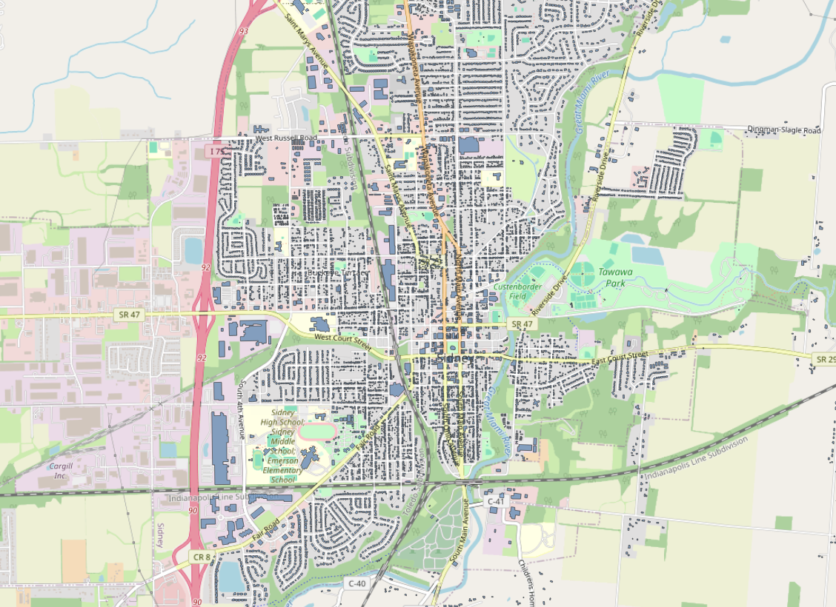
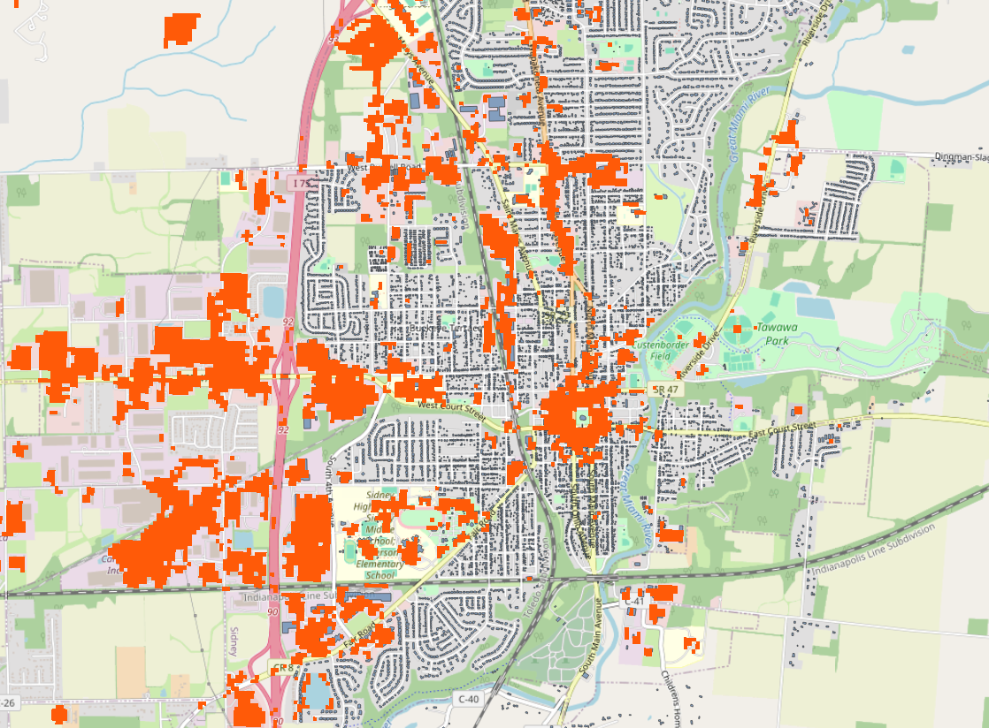
Overlay of Buildings and Urban Heat Island in Springfield (OSM)

Slide 14
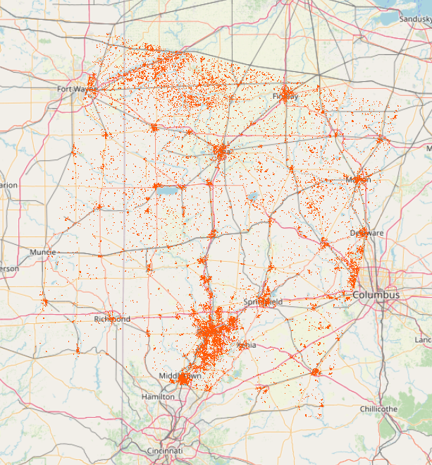
2. K-Means Clustering
Clustering Method: K-means clustering was applied with k=2 to partition the study area into two clusters based on LST and NDVI variations.
Cluster Interpretation:
Cluster with higher mean temperature values was identified as UHI (Urban Heat Island) hotspots.
Cluster with lower mean temperature values represented non-UHI regions.

Slide 15
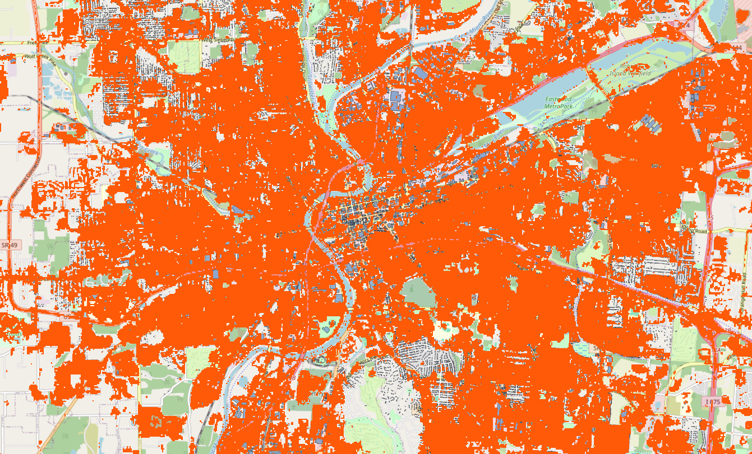
Overlay of Buildings and Urban Heat Island in Dayton (OSM)

Slide 16
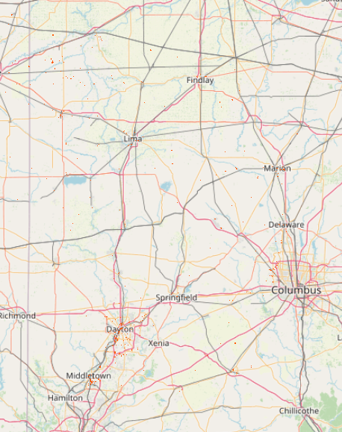
3. Random Forest Classification
By applying Random Forest classification to combined
LST and NDVI data, areas are classified as UHI
zones where:
LST exceeds mean temperature plus one
standard deviation.
The ensemble of 100 decision trees
collectively predicts UHI presence based
on learned patterns in LST-NDVI relationships.
The higher threshold (mean LST + 1 SD) identifies only the
most intense UHI zones, resulting in fewer but more significant
hotspots.

Slide 17
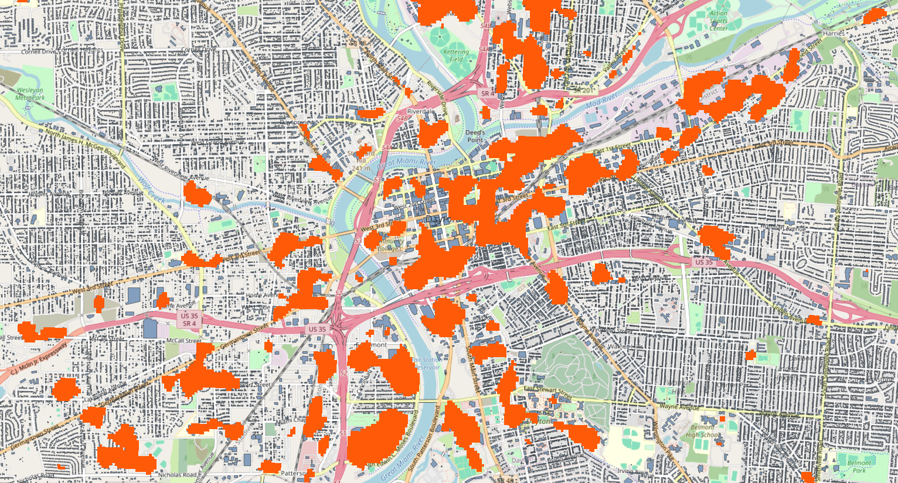
Overlay of Buildings and Urban Heat Island in Dayton (OSM)

Slide 18
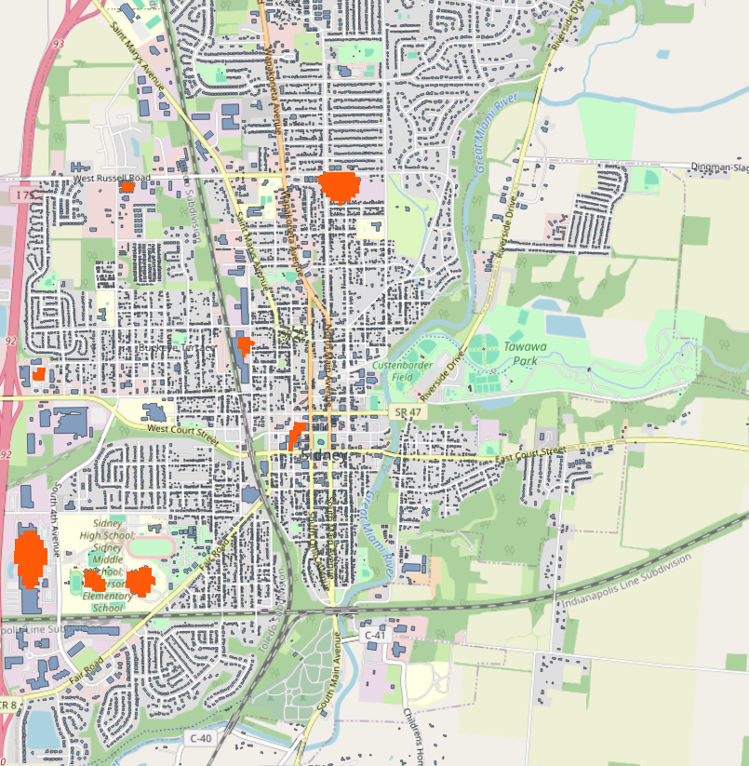
Overlay of Buildings and Urban Heat Island in Springfield (OSM)

Slide 19
Results and Analysis
Key Findings
Dense urban structures and building clusters exhibit significantly higher surface temperatures, creating persistent thermal hotspots in the urban landscape.
All three classification methods (Random Forest, K-means, and thresholding) consistently identified large building complexes as prominent UHI hotspots, confirming their significant impact on urban thermal patterns.
Areas with significant vegetation typically do not exhibit UHI effects.
Comparison of Methods
All three methods showed consistent hotspot detection.

Slide 20
Challenges and Adjustments
Challenges
Cloud coverage in imagery.
Resource-intensive data processing.
Coordinate system misalignment.
Adjustments
Stricter cloud cover filters.
Optimized processing scripts.
Unified coordinate systems.

